Slide 1

Alexa Skills
By: Emma Pinto and Aughdon Breslin

Slide 2
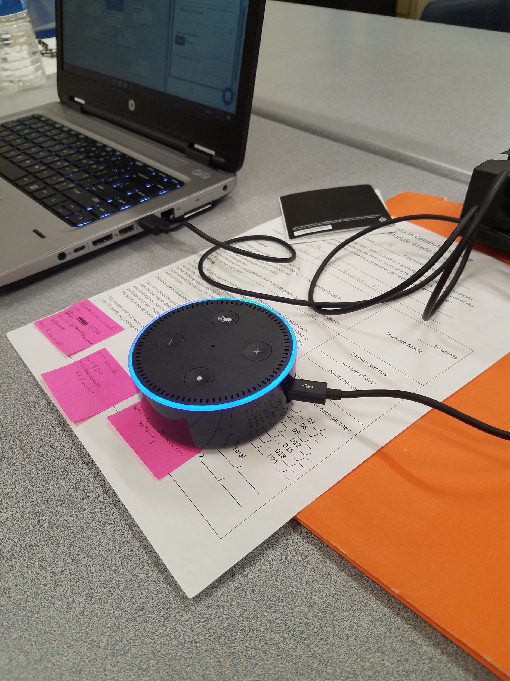
Original Goal
Create an Alexa skill that connects to Netflix and finds a show of our choice
It would navigate the directory, searching for genres,
titles, or series depending on our choice

Slide 3
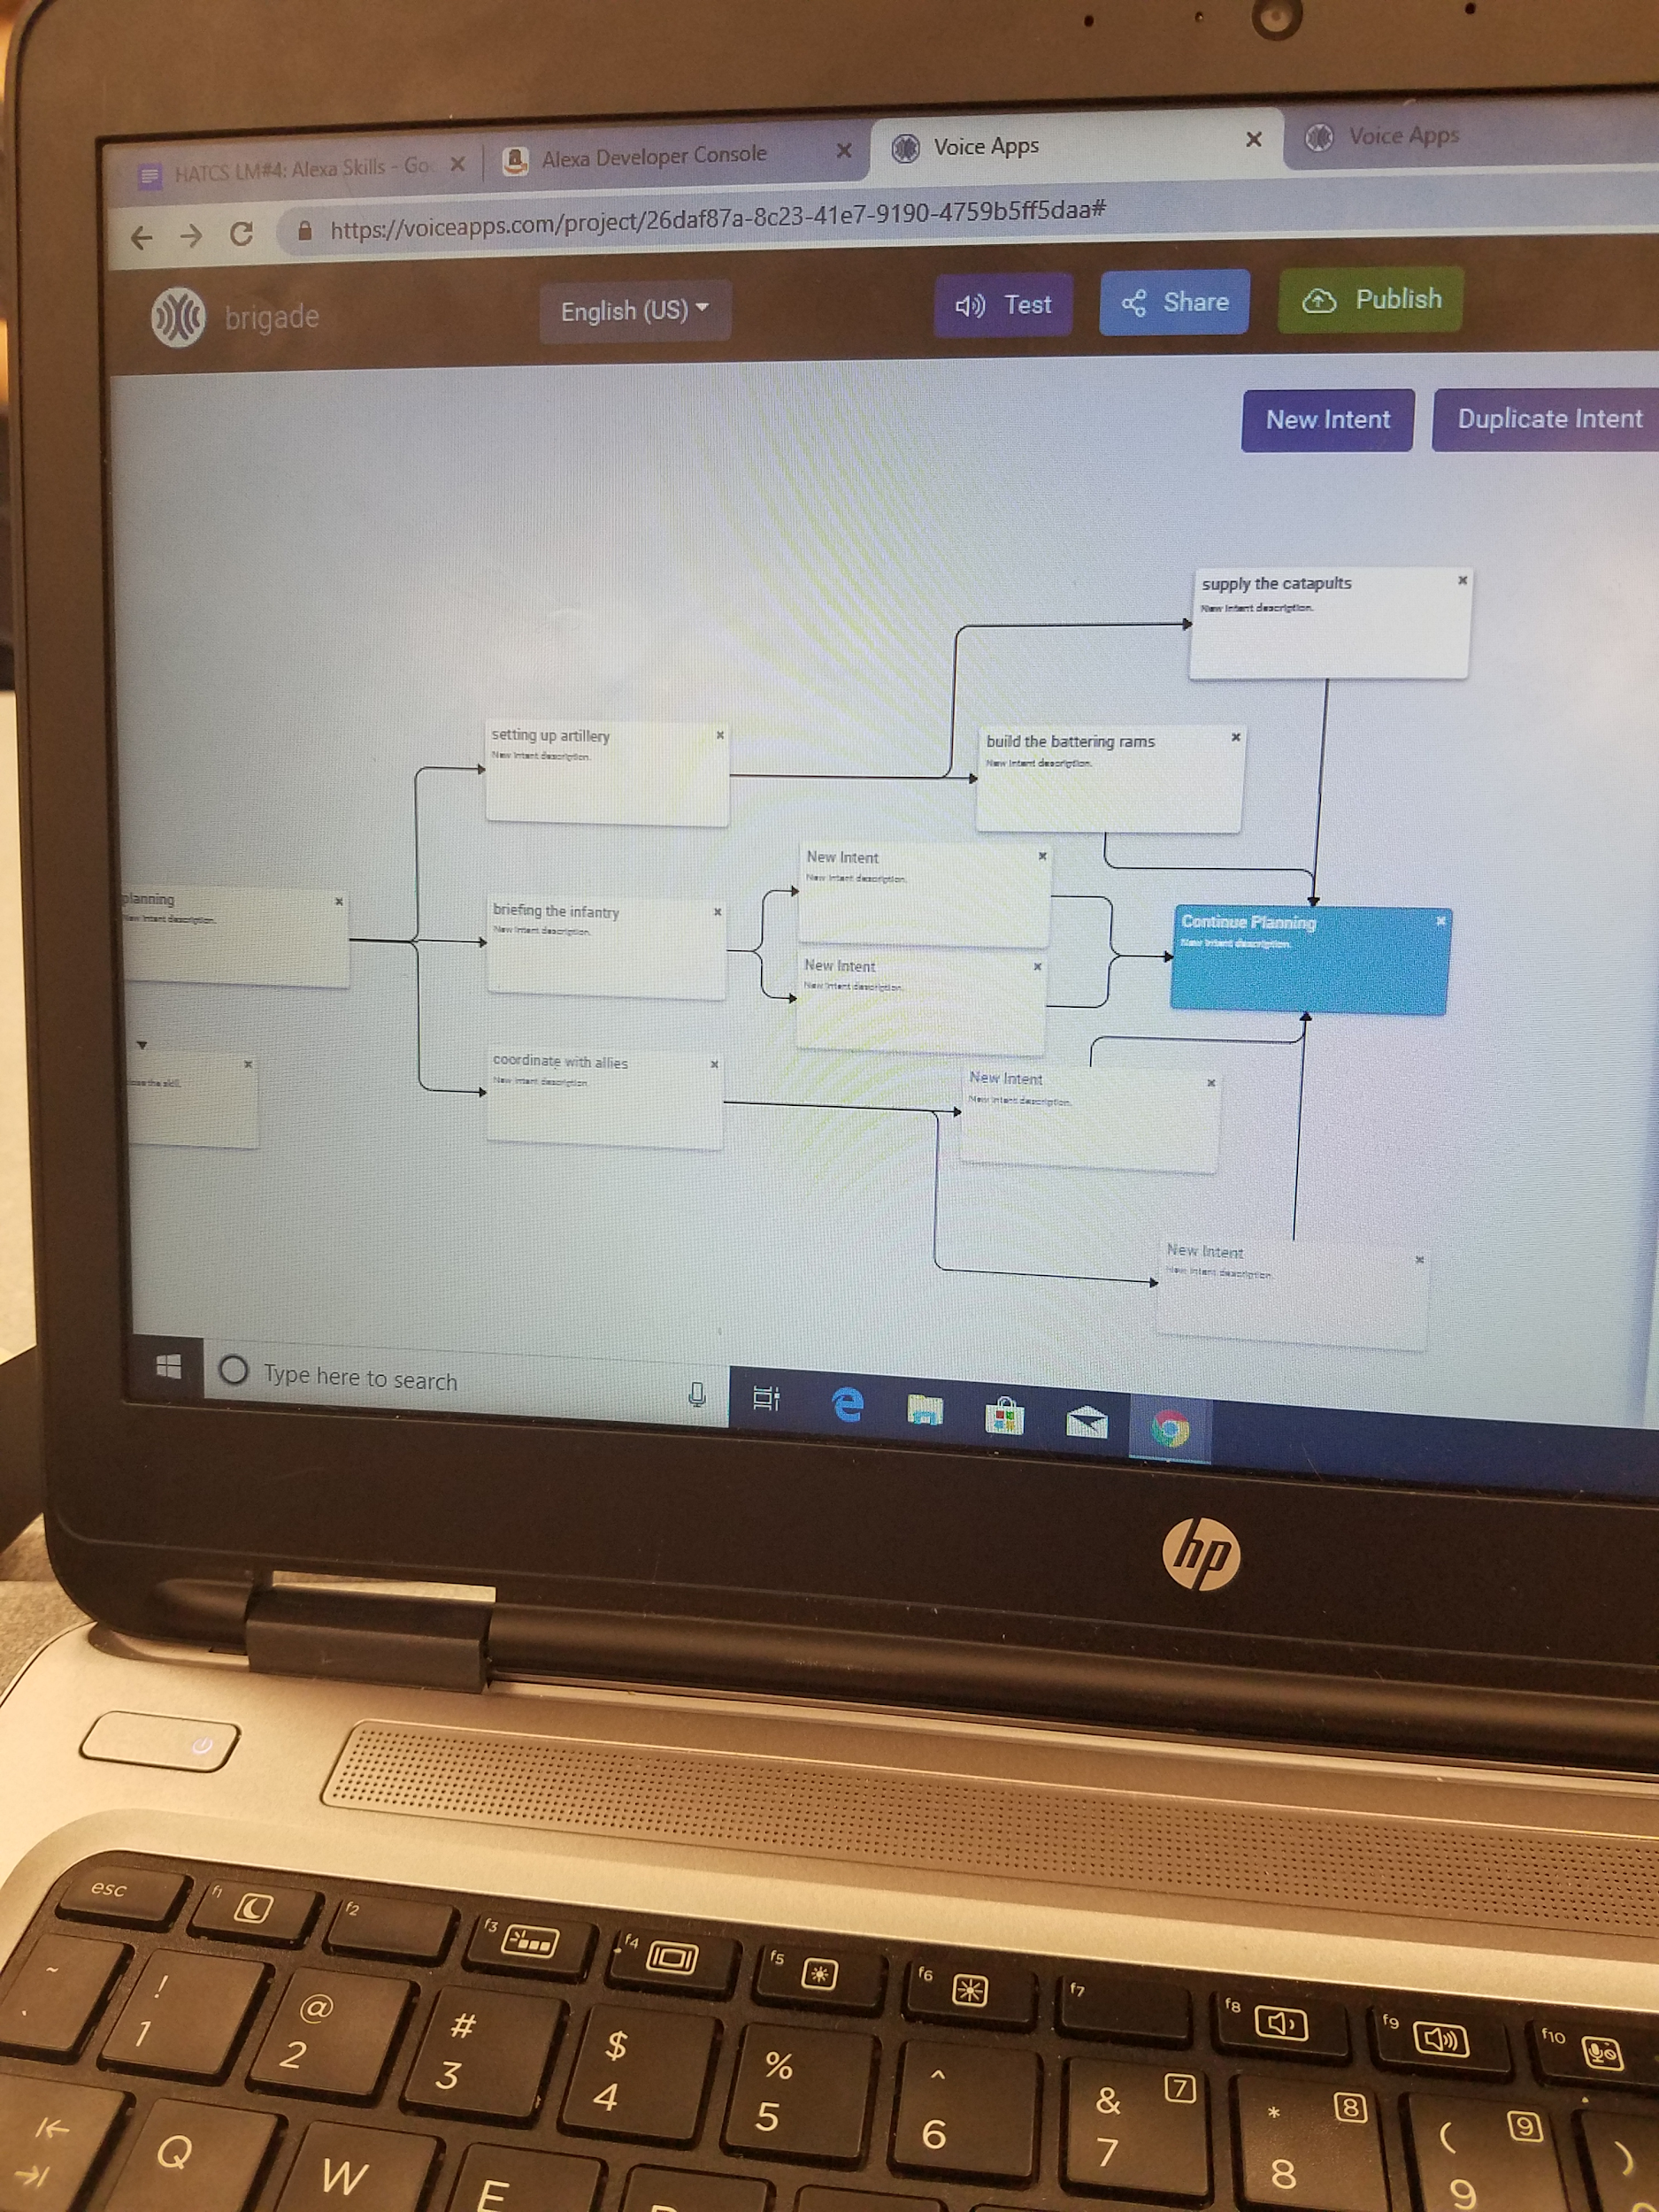
Resources
Alexa Developer
VoiceApps
Amazon AWS
Code Academy
https://medium.freecodecamp.org/how-to-use-your-tech-skill-to-create-alexa-skills-a3e9f210a952 (programming steps/tips)
https://dzone.com/articles/calling-aws-lambda-functions-from-alexa-part-1 (understanding lambda functions)

Slide 4
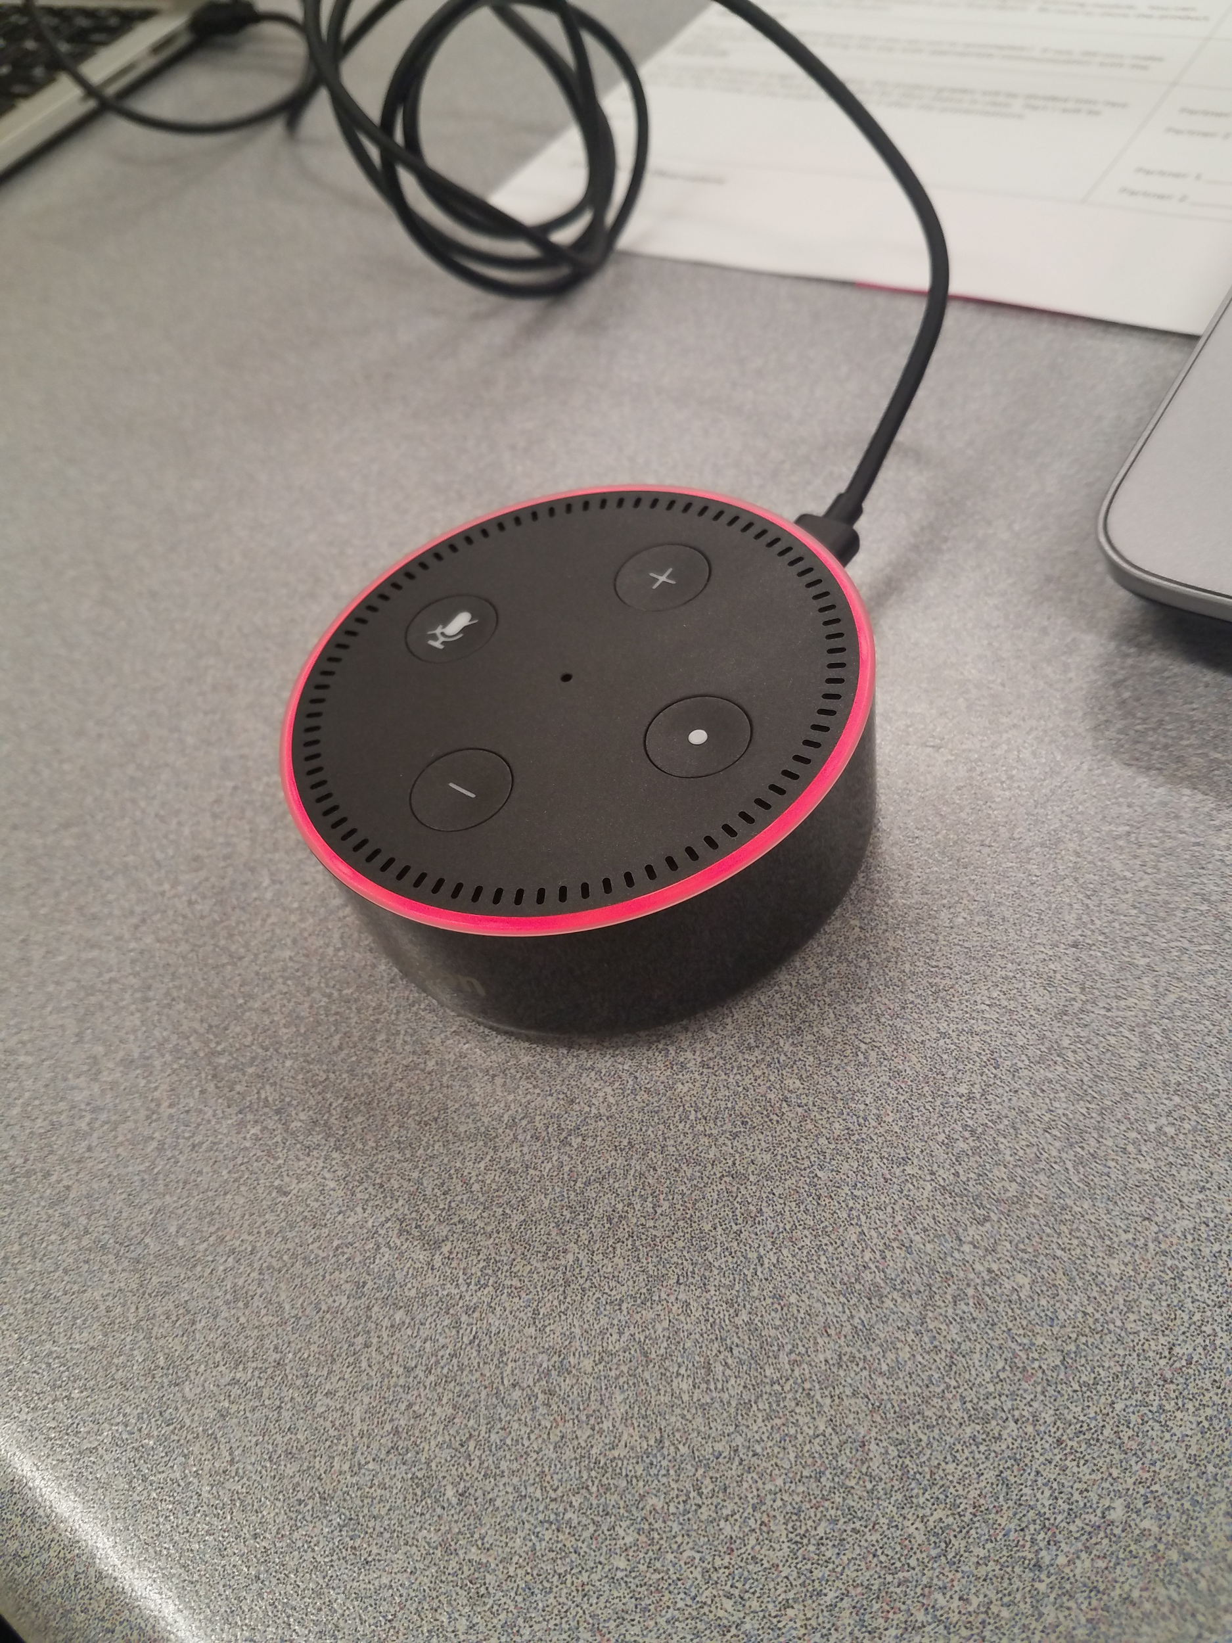
Problems We Encountered
Difficulty with Alexa Developer
Echo Dot was not compatible with Netflix, only with Amazon Fire TV
Spotify not being compatible with Echo Dot
Setting up Echo Dot and all accounts took a lot of time
Alexa not responding to keywords
Alexa not recognizing and accessing the skill

Slide 5
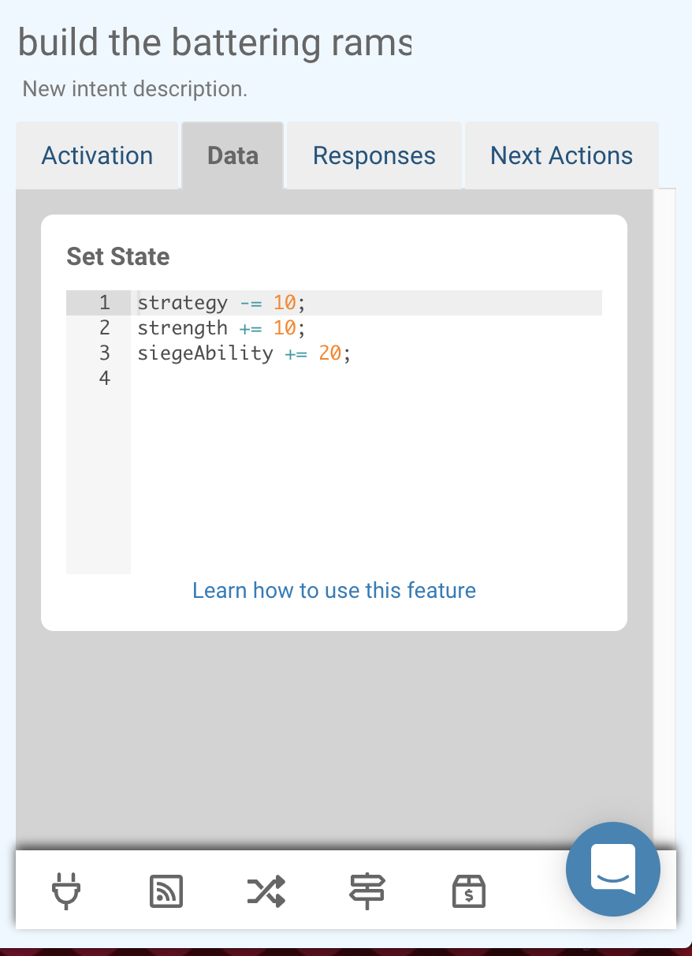
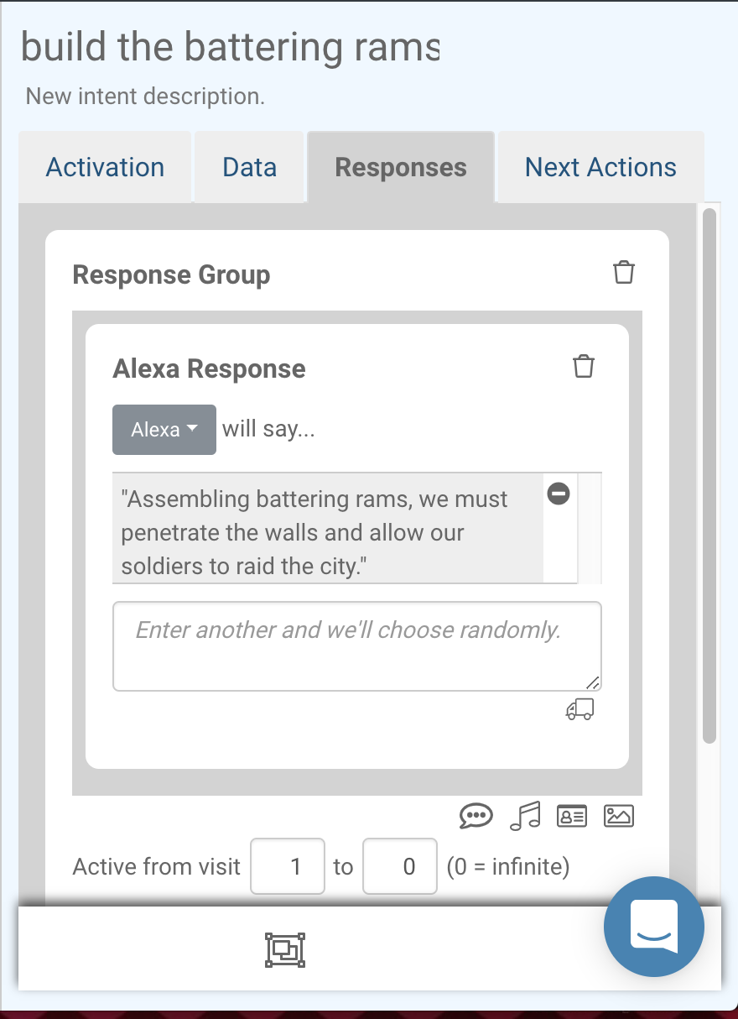
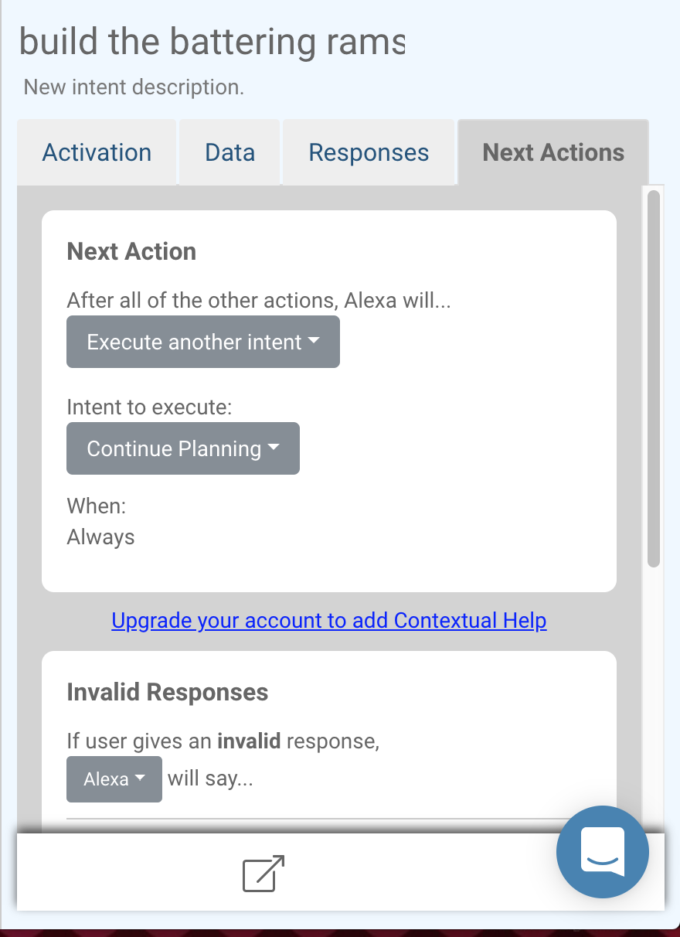
Accomplishments
Made a skill that allows Alexa respond to simple requests
Made all intents within the skill work with each other
Got Alexa Developer connected to VoiceApps sight

Slide 6
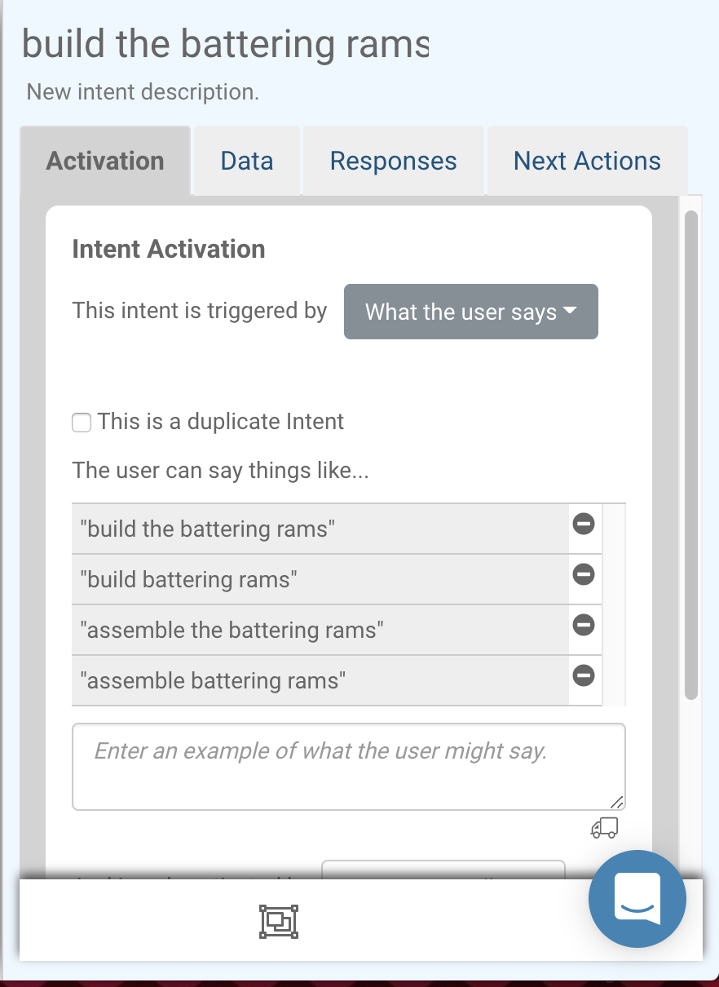
Lessons Learned
How to code an Alexa Skill
How lambda function works (export)
How intents within a skill work together
How to change variable values throughout the skill

Slide 7
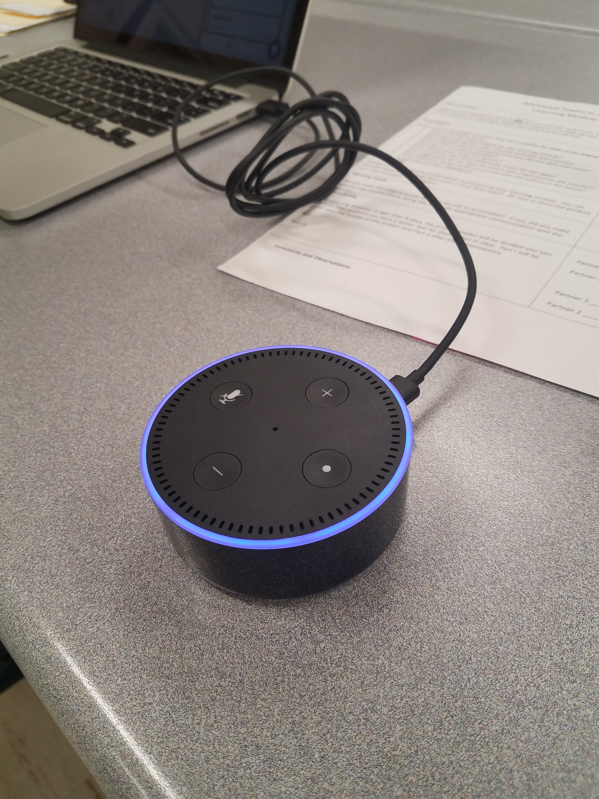
What We Could Have Done Differently
Started working in VoiceApps a lot sooner
Played with the Alexa App less
Used it a lot less than we thought we would

Slide 8
Our Suggestions
Don’t worry about the Alexa App too much
Start out with small skills
Watch Tutorials/Research how other people made skills
Start out in VoiceApps
Explore sample tasks to see what you want to create

Slide 9
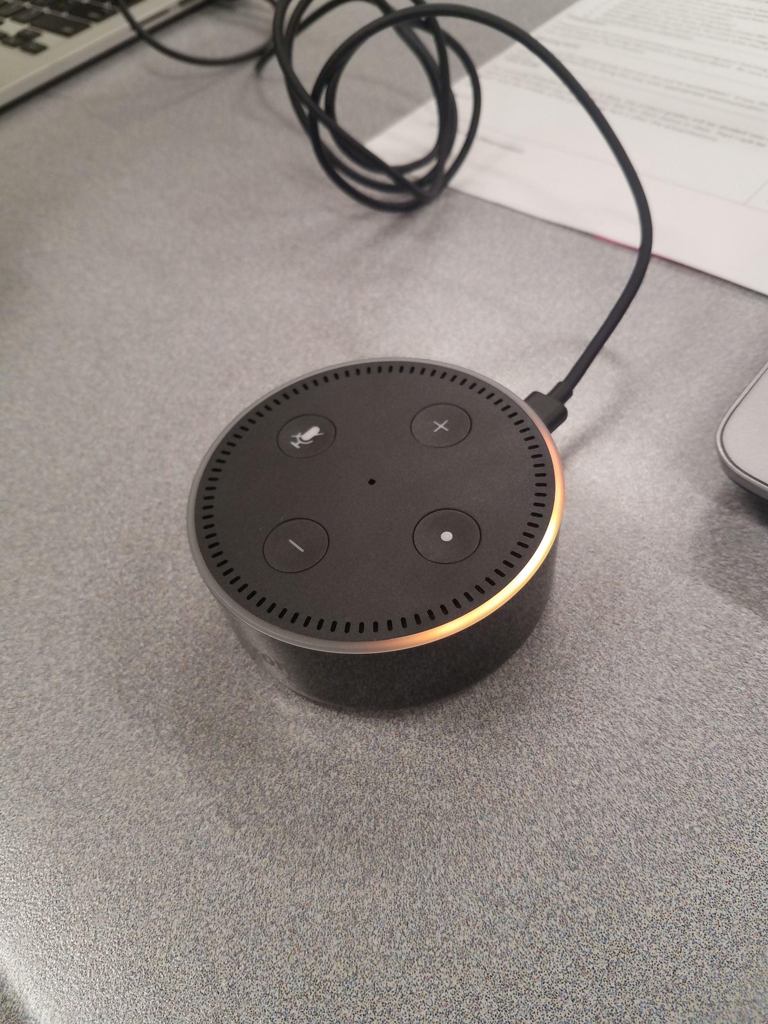
Things We Could Do in the Future
Have Alexa open different websites or apps (not Netflix)
Connect Echo Dot to phones or other electronics
Turn up volume on music
Make a light turn on
Keep building on the skill we have now

Slide 10
Summary
Overall successful project
Trying to get the Amazon AWS and Developer accounts to work was frustrating at first
Didn’t realize what our original goal entailed
VoiceApps was a success
We ended up making a cool skill

